Slide 1


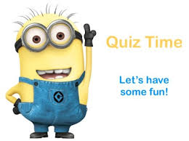
Friends of Oakley Infant School
Quiz for kids

Slide 2
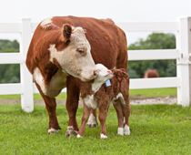
Animals - Babies
1. If the mother is a cow, what do we call the baby?
Piglet
Cub
Calf
Foal

Slide 3
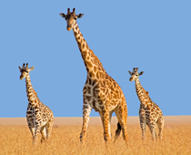
Animals - Babies
2. Baby giraffes are called calves. They are like their mothers, but smaller. They are born with long _____ and _____.
Arms and Legs
Ears and Arms
Legs and Necks
Necks and Arms

Slide 4
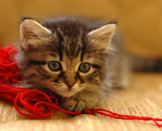
Animals - Babies
3. This kitten is a baby. Kittens are baby _____.
Dogs
Cats
Lions
Tigers

Slide 5
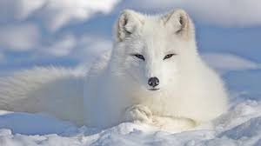
Animals - Babies
4. These beautiful mammals have fur on their paws so they can walk on snow and ice without getting cold. It is a ________.
Wolf
Polar Bear
Arctic Fox
Snow Leopard

Slide 6
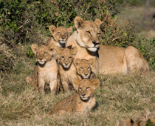
Animals - Babies
5. This is a family of lions. Lions are big cats. But their babies are called _____.
Kittens
Cubs
Leopards
Calves

Slide 7
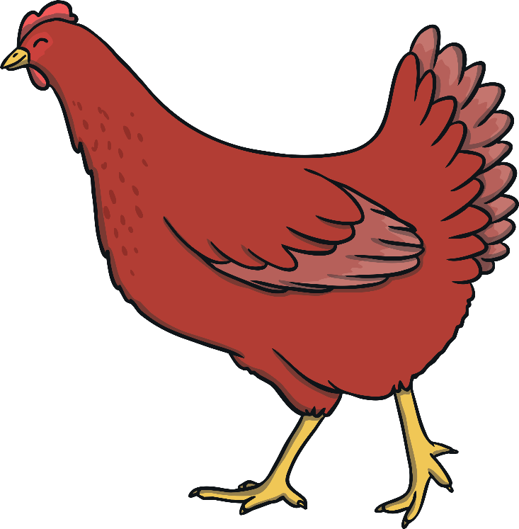
Name The Story
1. A little hen plants and grows some wheat, grinds some flour and makes a loaf of bread without any help from the other animals until it is time for the bread to be eaten

Slide 8
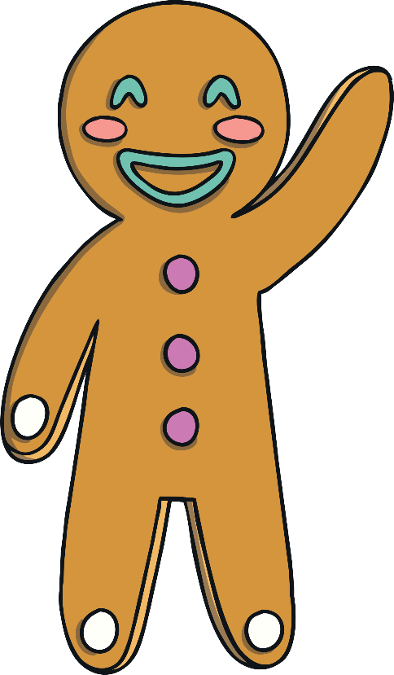
Name The Story
2. A biscuit runs away and is chased by lots of people and animals. He tries to cross over a river with the help of a sneaky fox

Slide 9
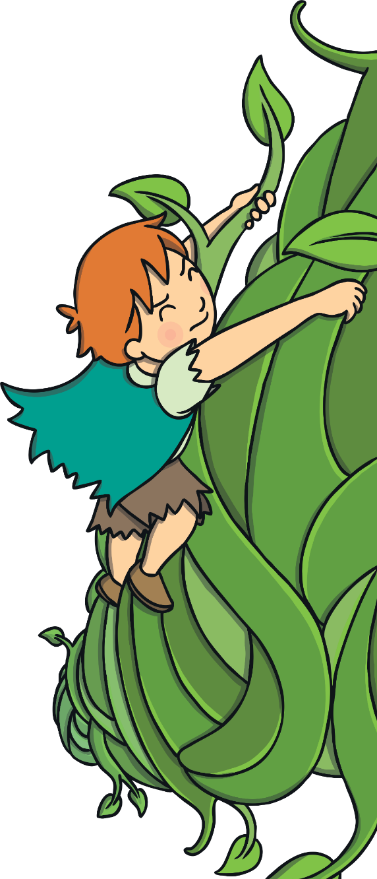
Name The Story
3. A little boy grows an enormous beanstalk, finds a giant’s castle and a rather special goose.

Slide 10
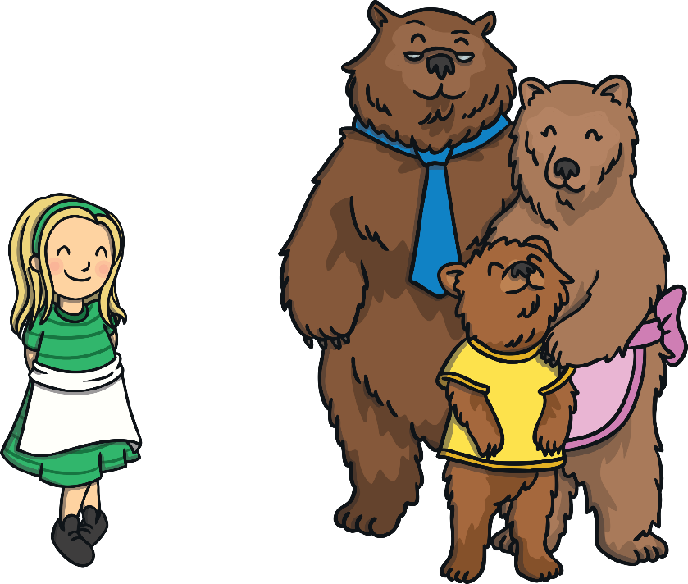
Name The Story
4. A little girl goes into a cottage she finds in the woods. She eats some food, breaks a chair and goes to sleep in a little bed. Then the homeowners come back!

Slide 11



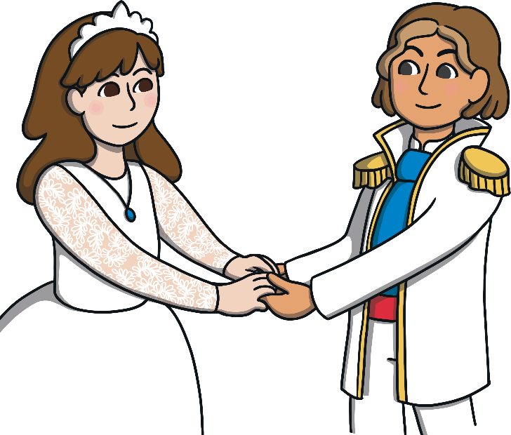
Name The Story
5. A witch puts a spell on a boy and turns him into a beast. He lives in a castle and falls in love with a beautiful girl.

Slide 12
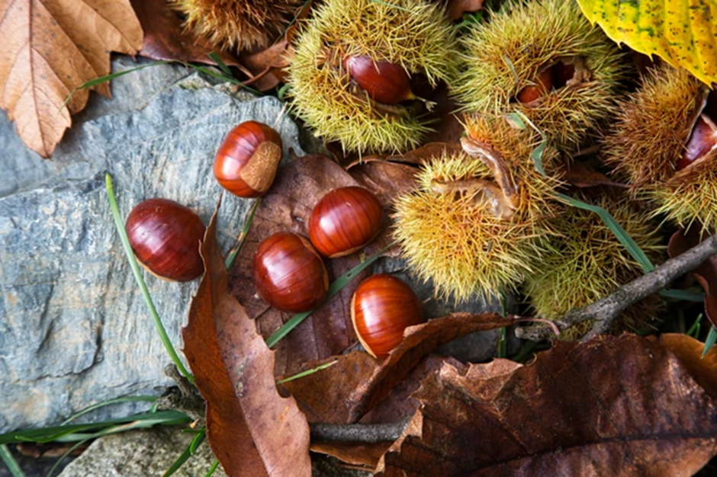
British Trees
1. Can you identify which tree this comes from?

Slide 13
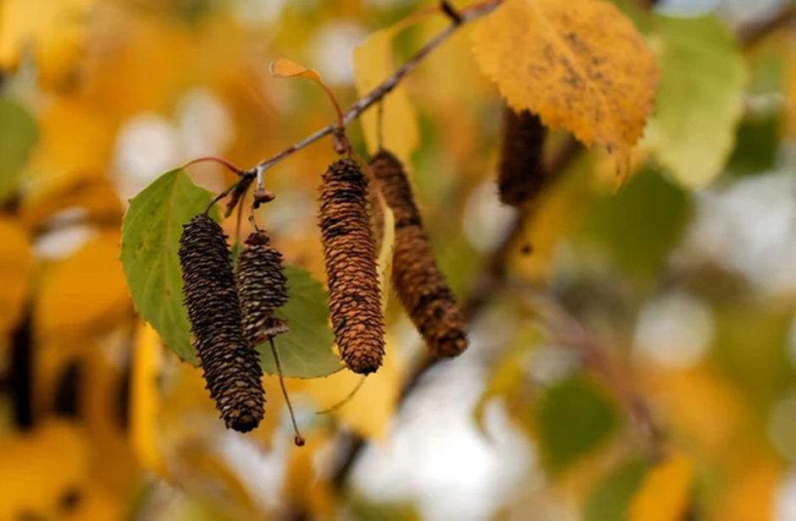
British Trees
2. Can you identify which tree this comes from?

Slide 14
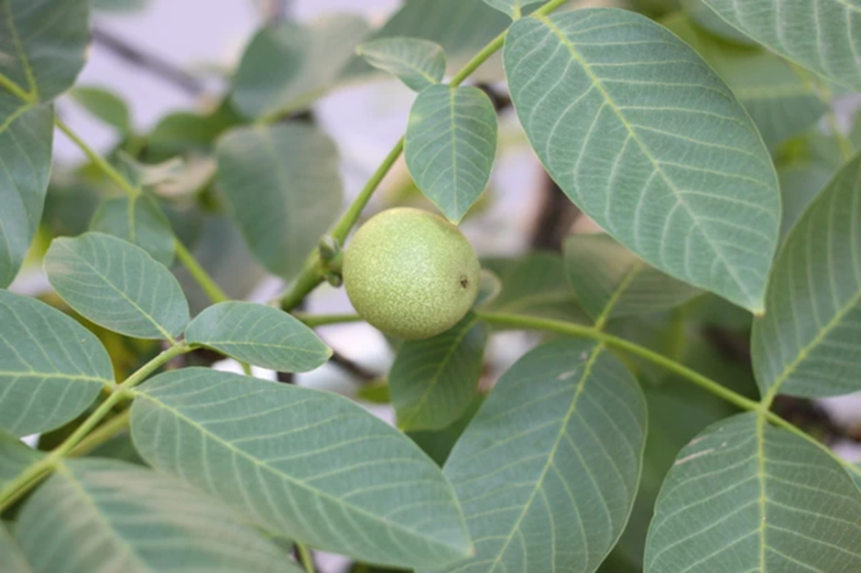
British Trees
3. Can you identify which tree this comes from?

Slide 15
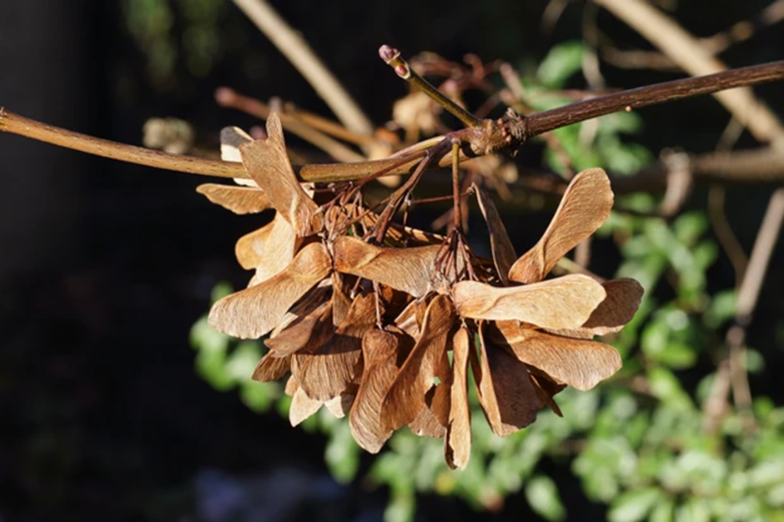
British Trees
4. Can you identify which tree this comes from?

Slide 16
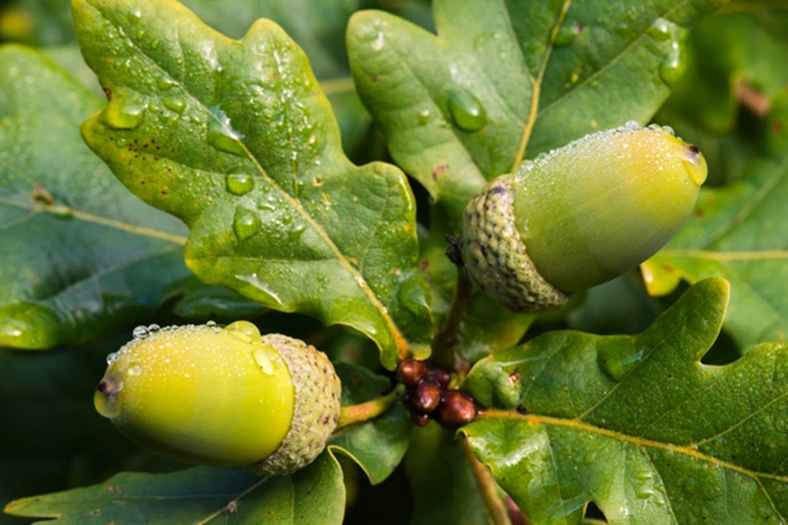
British Trees
5. Can you identify which tree this comes from?

Slide 17
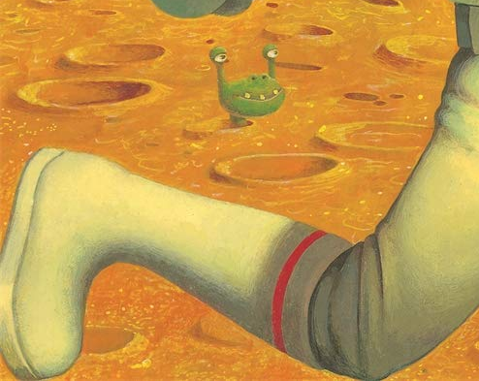
Name The Book
1. Can you guess which book this picture has been taken from?

Slide 18

Name The Book
2. Can you guess which book this picture has been taken from?

Slide 19
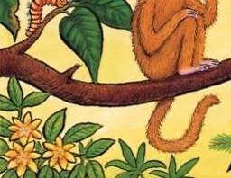
Name The Book
3. Can you guess which book this picture has been taken from?

Slide 20
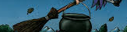
Name The Book
4. Can you guess which book this picture has been taken from?

Slide 21
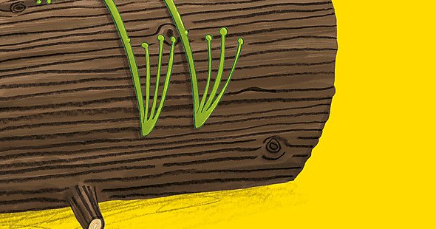
Name The Book
5. Can you guess which book this picture has been taken from?

Slide 22
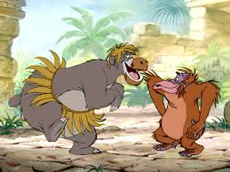
Guess The Movie
1. Can you guess what movie this is from?

Slide 23
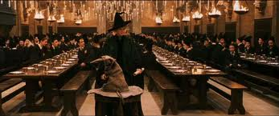
Guess The Movie
2. Can you guess what movie this is from?

Slide 24
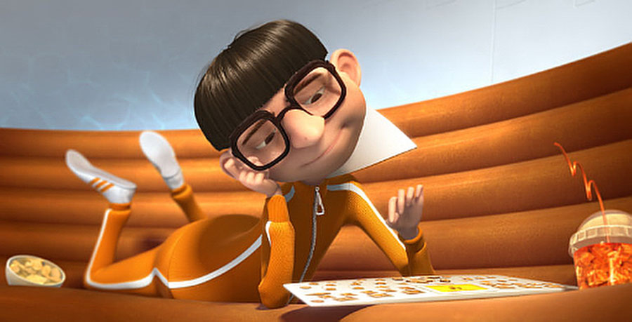
Guess The Movie
3. Can you guess what movie this is from?

Slide 25
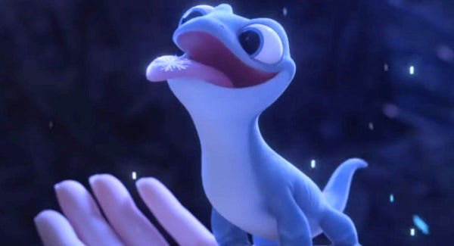
Guess The Movie
4. Can you guess what movie this is from?

Slide 26
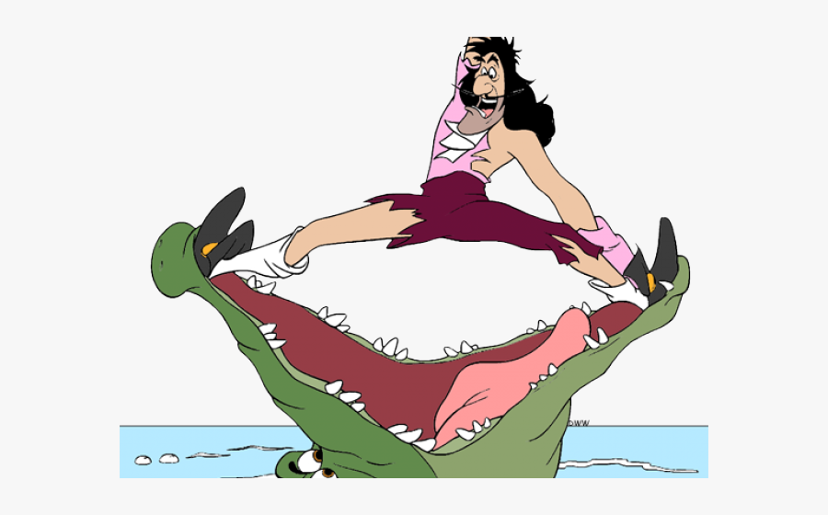
Guess The Movie
5. Can you guess what movie this is from?

Slide 27



