Slide 1

Friends of Oakley Infant School
Trivia night

Slide 2
How it works:
9 x Rounds
5 x questions in each round
There is break in the middle ☺
You mark your own answers – Please be honest – grab a pen and paper
Relax and unmute yourself (Unless your debating an answer)

Slide 3
PRIZES
3rd Place -
2nd Place -
1st Place -

Slide 4
Round 1
Young at heart

Slide 5
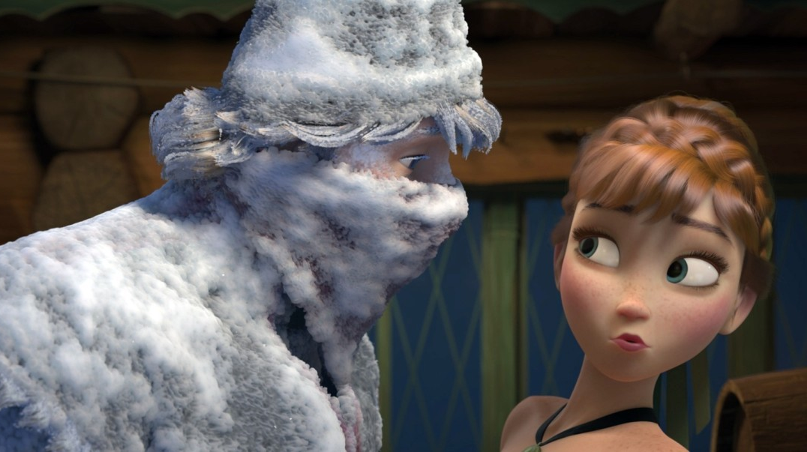

Slide 6
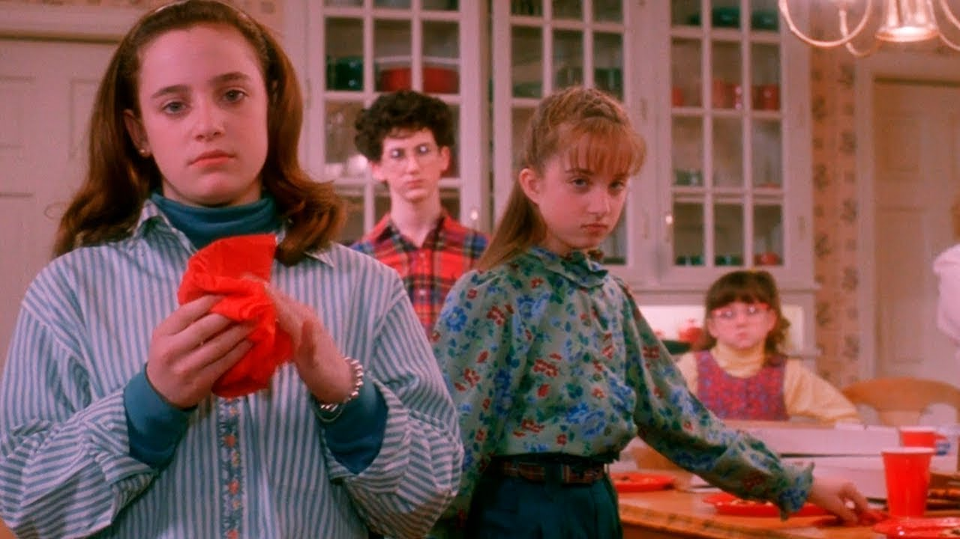

Slide 7
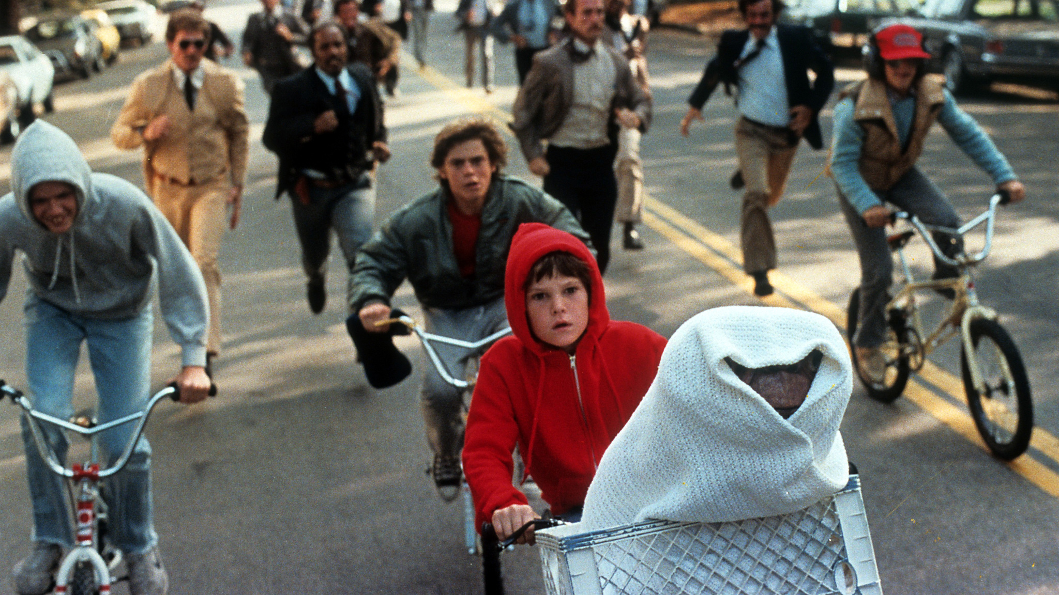

Slide 8


Slide 9
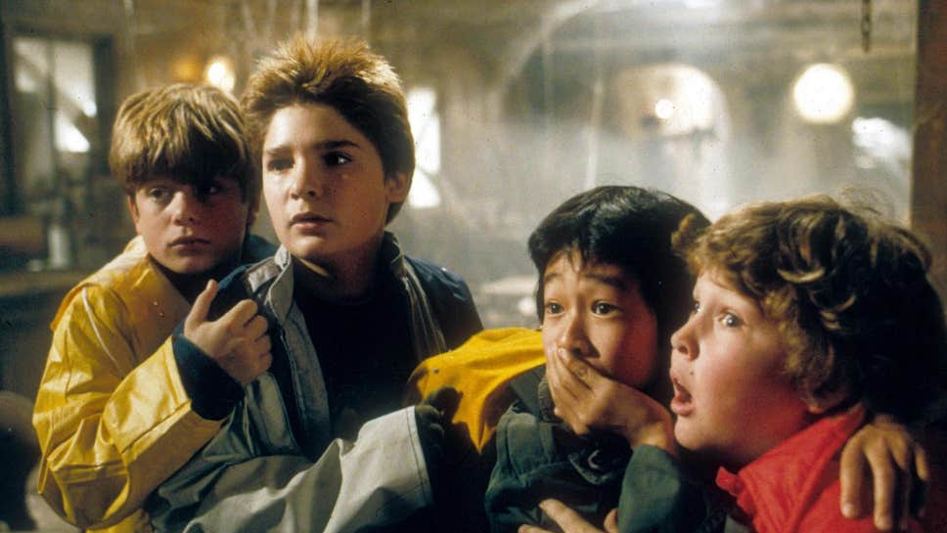

Slide 10
Round 2
Village Covidiot

Slide 11
The government has divided the nation into three tiers. But which tier is London in today?

Slide 12
If you live in Edinburgh. Can you order a pint at 9.45pm?

Slide 13
If you live in Newcastle upon Tyne. Are you allowed to get plasterer to come into your house to do some work?

Slide 14
If you live in Oakley, can two families of four meetup for a walk?

Slide 15
Which one of these isn’t a real UK government COVID-19 slogan, but which one?
“Stay home, protect the NHS, save lives”
“Stay alert, control the virus, save lives”
“Hands, Face, Space”
“Person, woman, man, camera, TV”

Slide 16
Round 3
The Mystery Biscuit

Slide 17
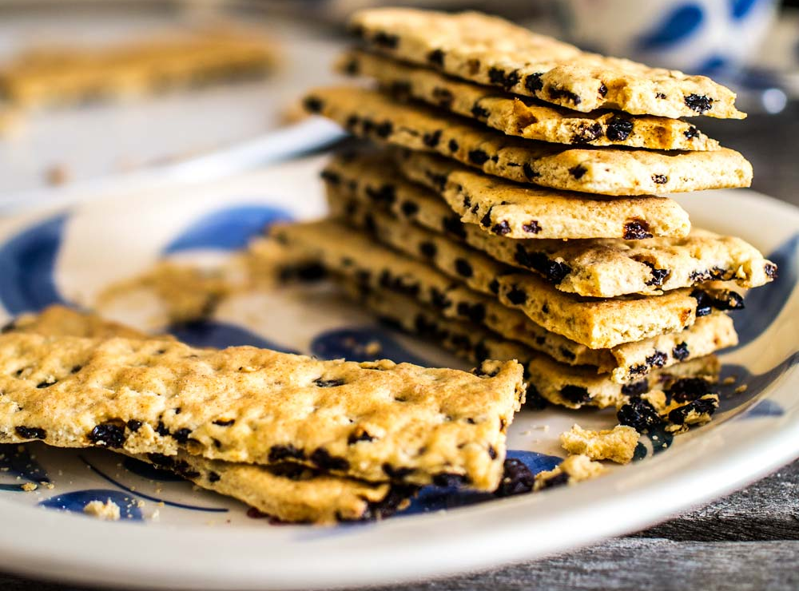

Slide 18
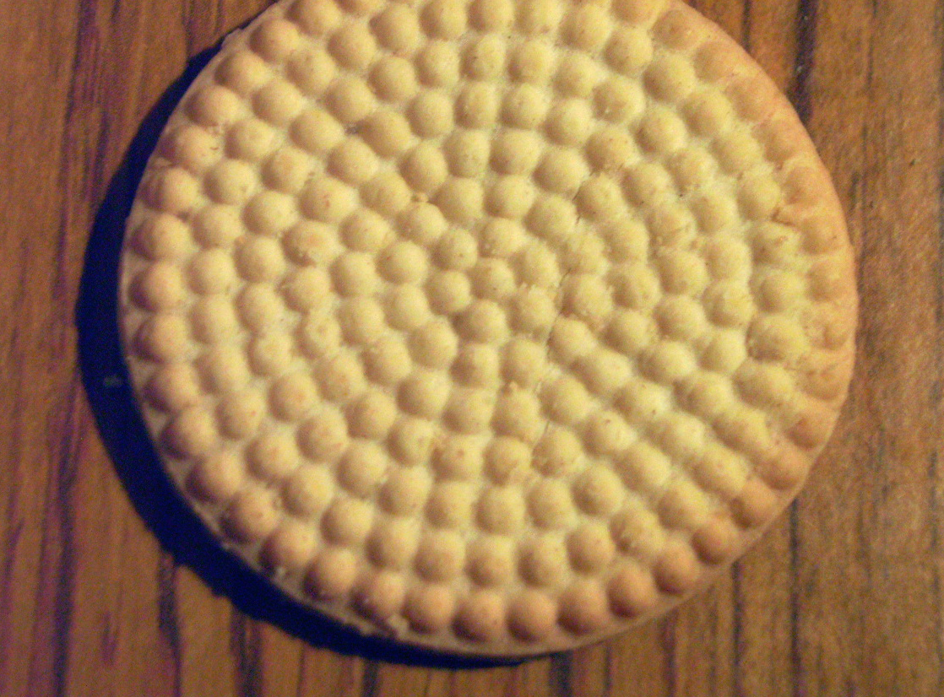

Slide 19
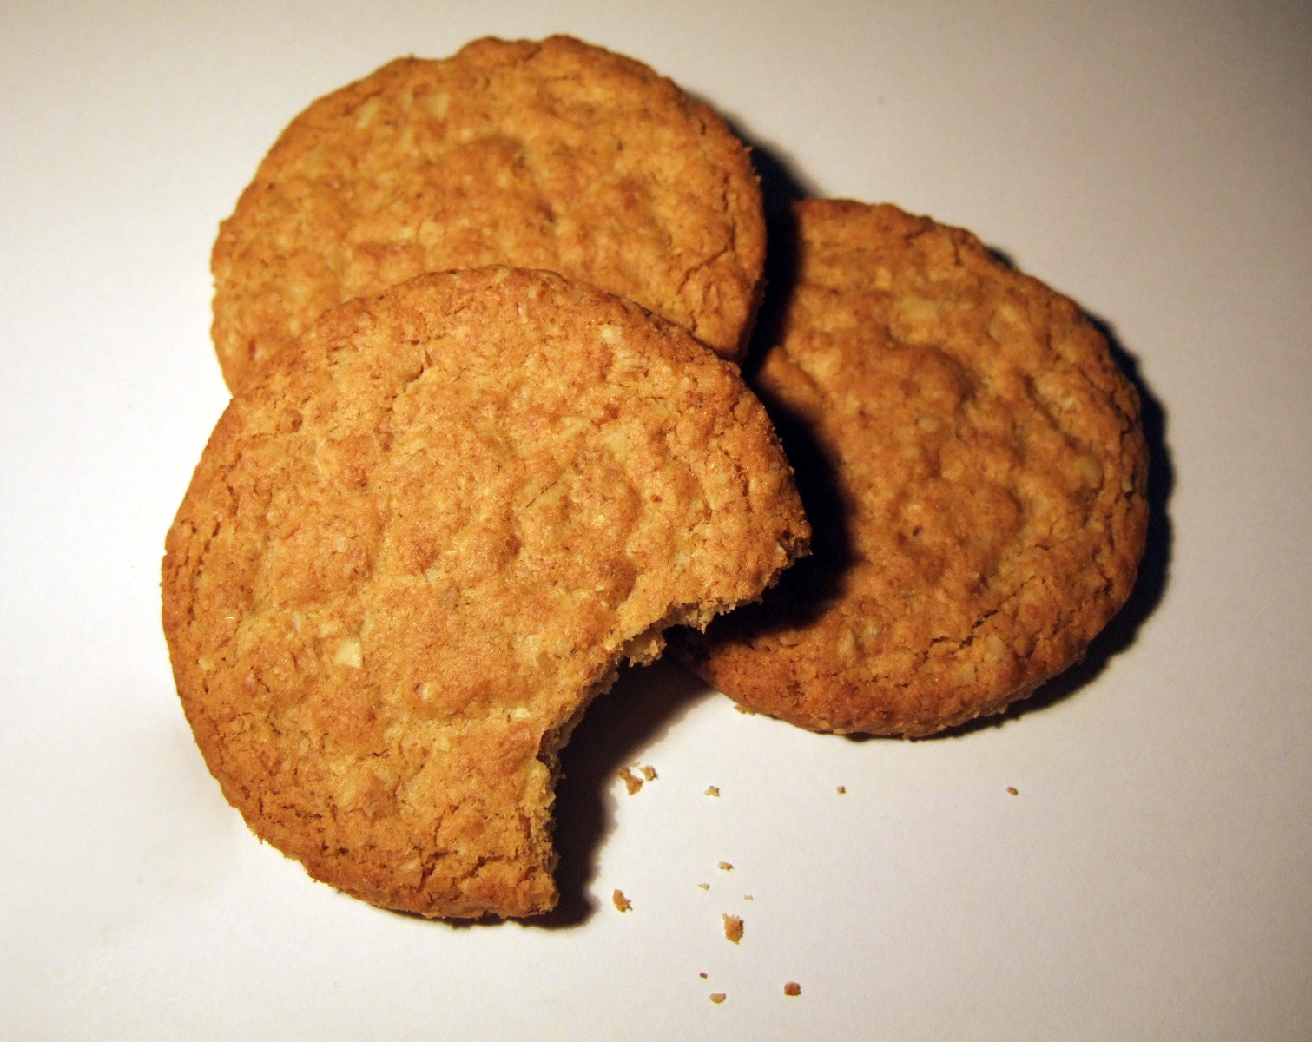

Slide 20
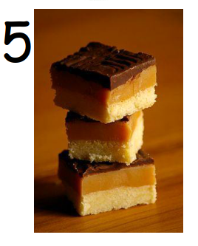

Slide 21
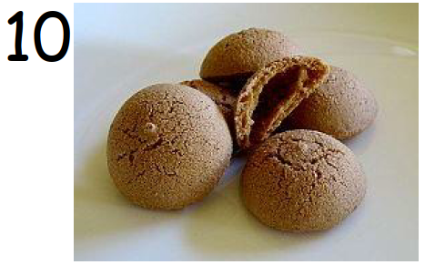

Slide 22
Round 4
ApOAKLEYpse Now

Slide 23


Slide 24
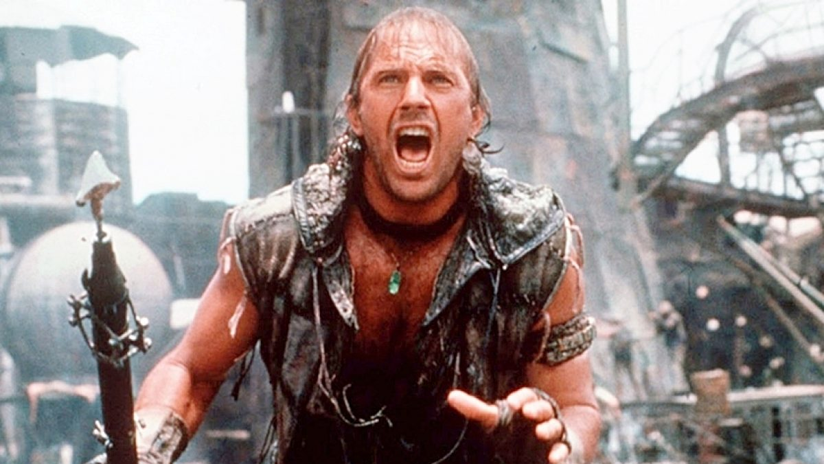

Slide 25


Slide 26
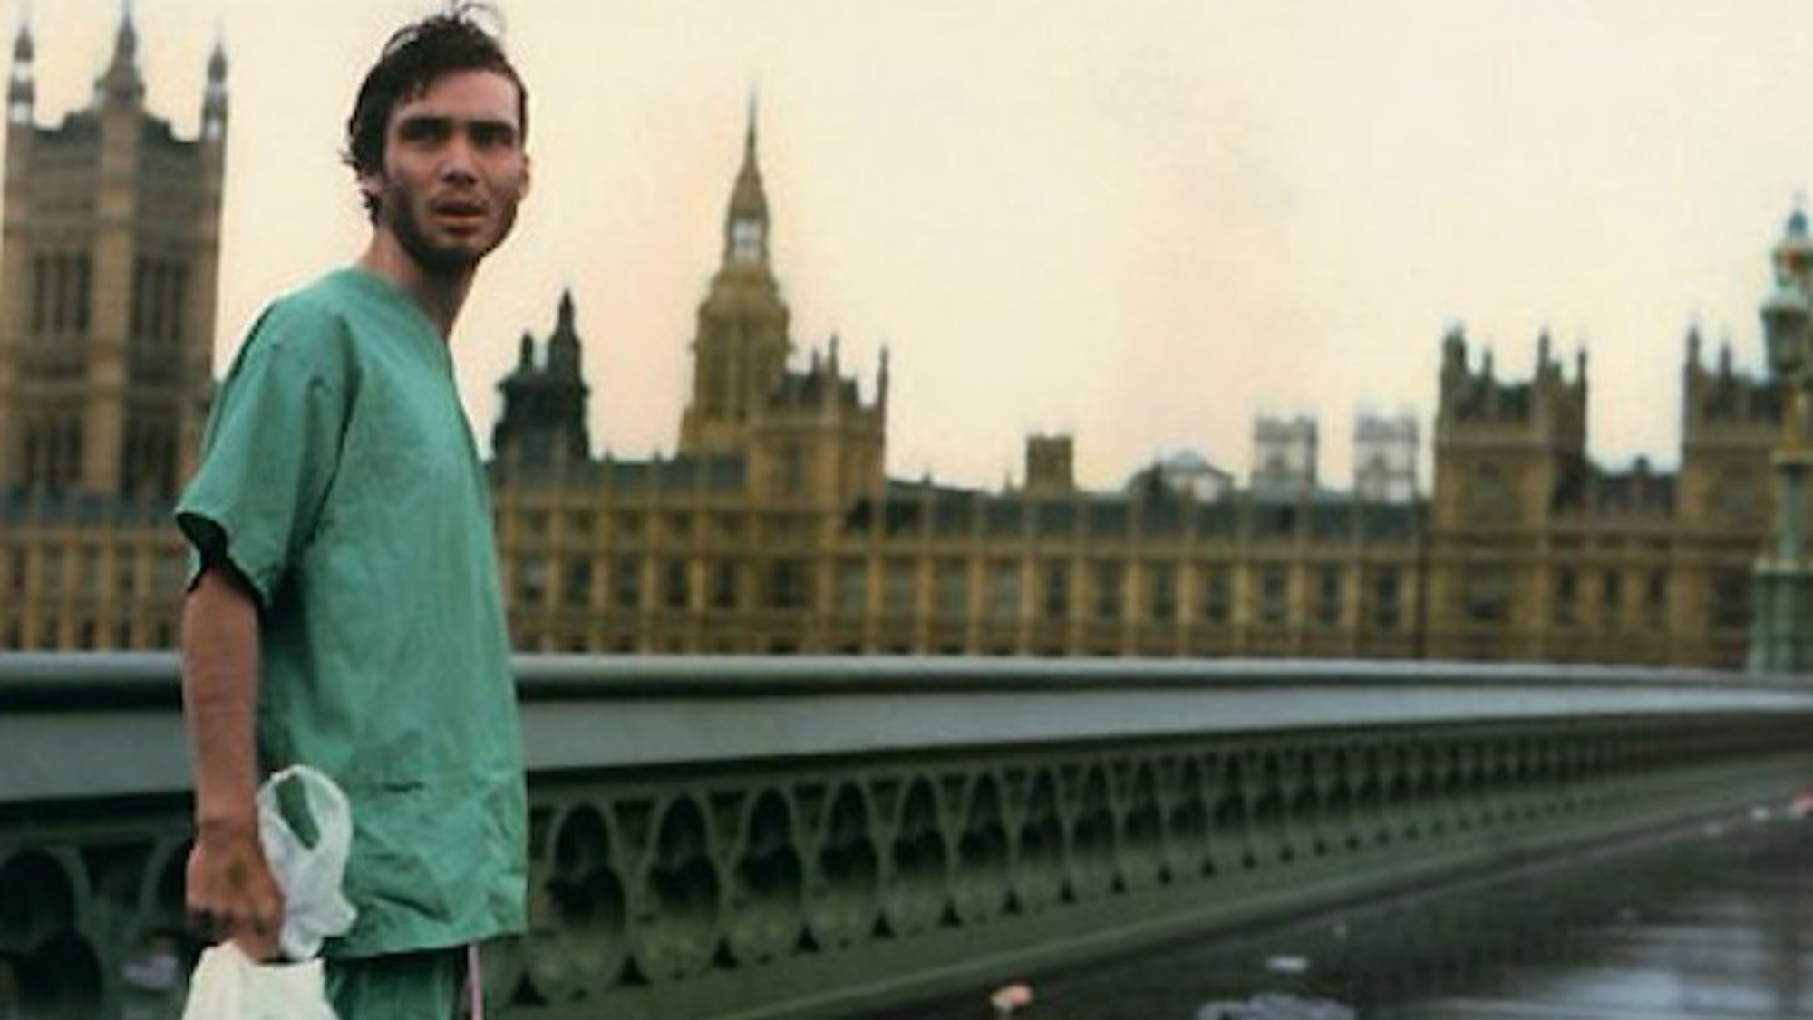

Slide 27
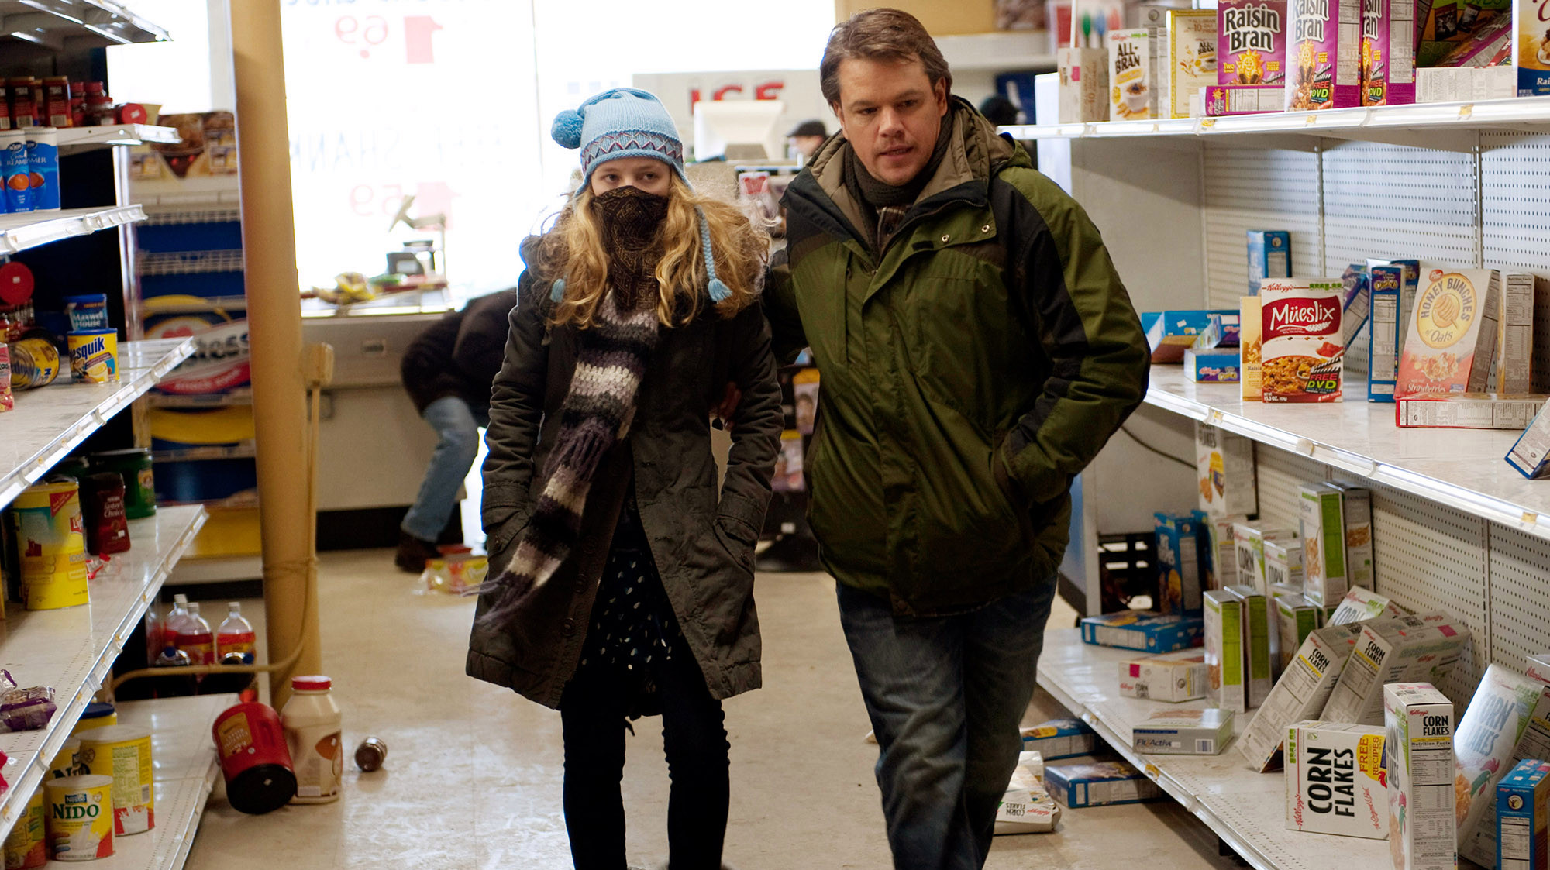
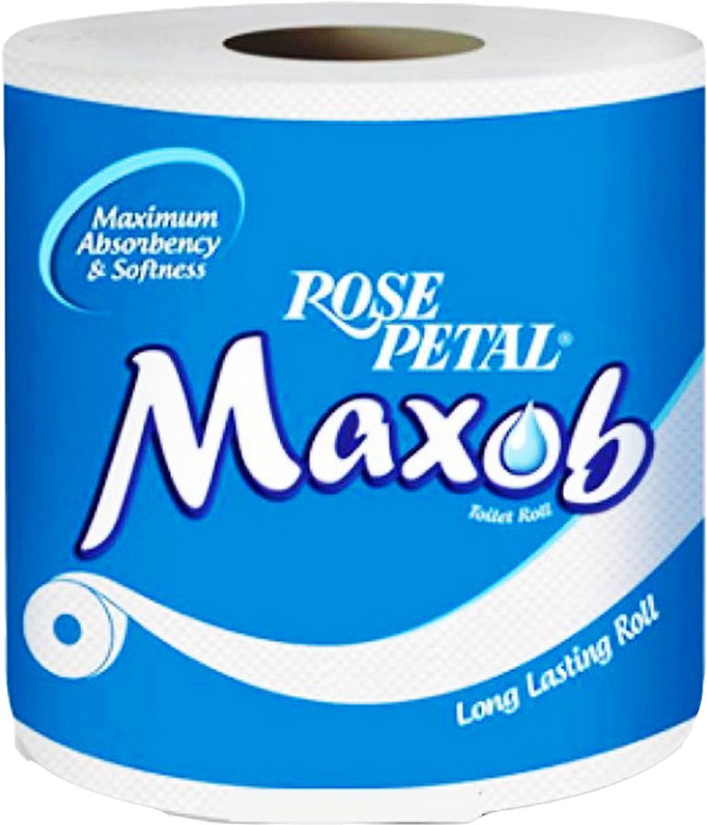

Slide 28
Round 5
Band on the run

Slide 29
Which country are these bands from?
AC/DC

Slide 30
Daft Punk

Slide 31
Arcade Fire

Slide 32
Scorpions

Slide 33
ABBA

Slide 34
Round 6
“You’re gonna need a bigger quote!”

Slide 35
“Chewie, we’re home!”

Slide 36
“I’m the king of the world!”

Slide 37
“Hello. My name is Inigo Montoya. You killed my father. Prepare to die.”

Slide 38
“Roads? Where we're going we don't need roads.”

Slide 39
“I’ll have what she’s having”

Slide 40
When can we have a break?
Now

Slide 41
Round 7
Pitch perfect

Slide 42
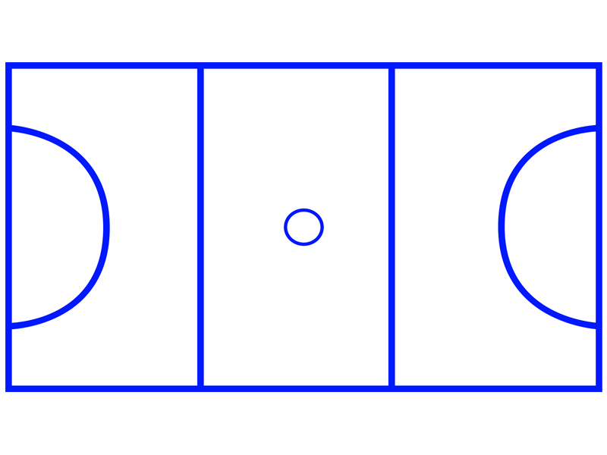

Slide 43
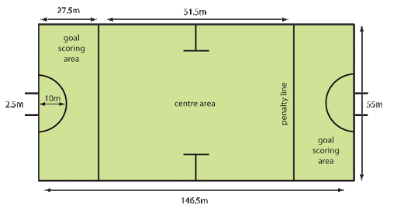

Slide 44


Slide 45
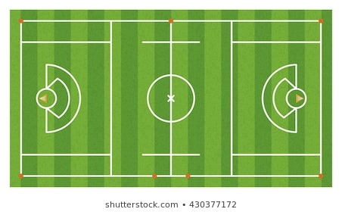

Slide 46
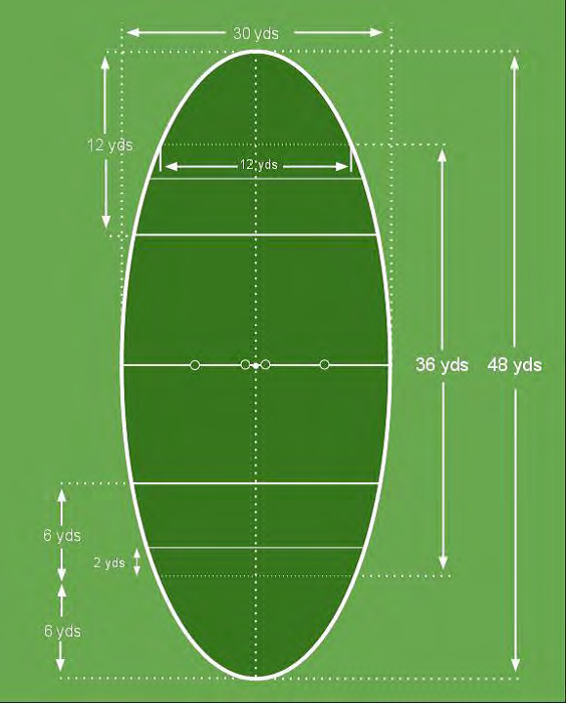

Slide 47
Round 8
The cherry on top

Slide 48
These are ingredients for which dessert…?
Sponge cake
Coffee
Brandy
Chocolate
Mascarpone

Slide 49
White bread
Mixed berries
sugar

Slide 50
eggwhite
Cream
Sugar
Fruit

Slide 51
Pastry
Sugar
Jam
Eggs
Almonds

Slide 52
Icecream
Jam
Sponge

Slide 53
That concludes the questions

