Slide 1

Friends of Oakley Infant School
Trivia night
Answers

Slide 2
Round 1
Young at heart

Slide 3
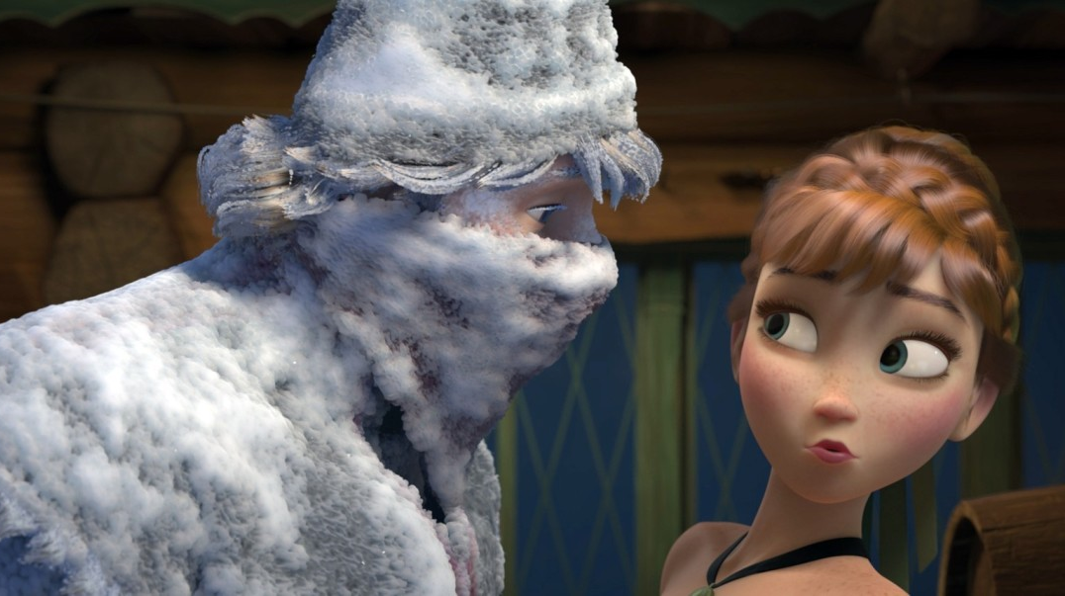
Frozen

Slide 4
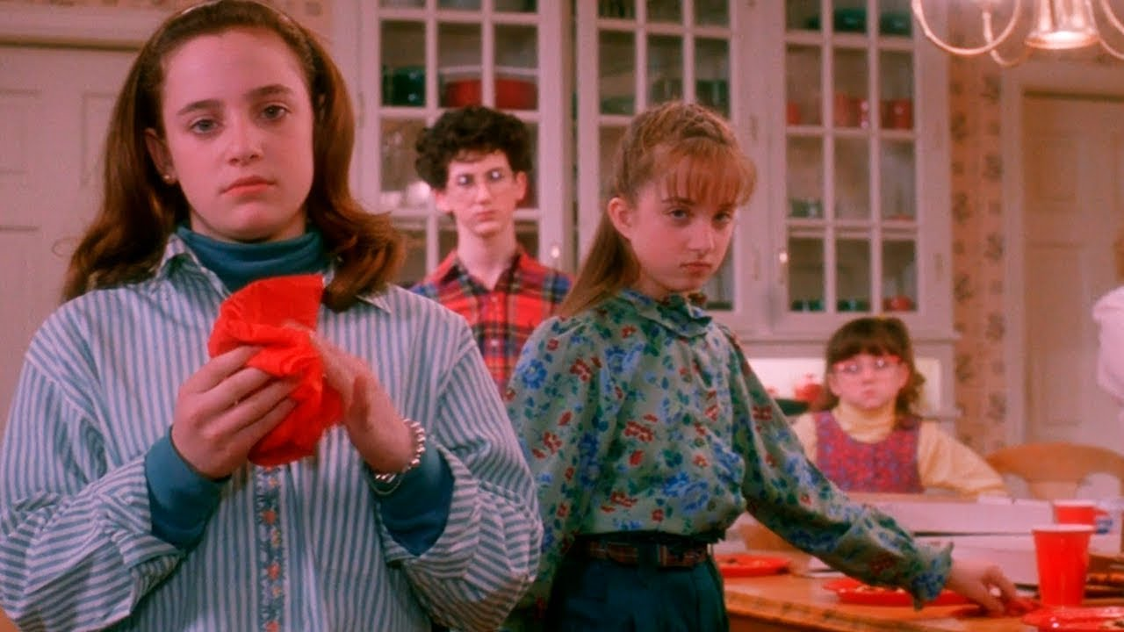
Home Alone

Slide 5
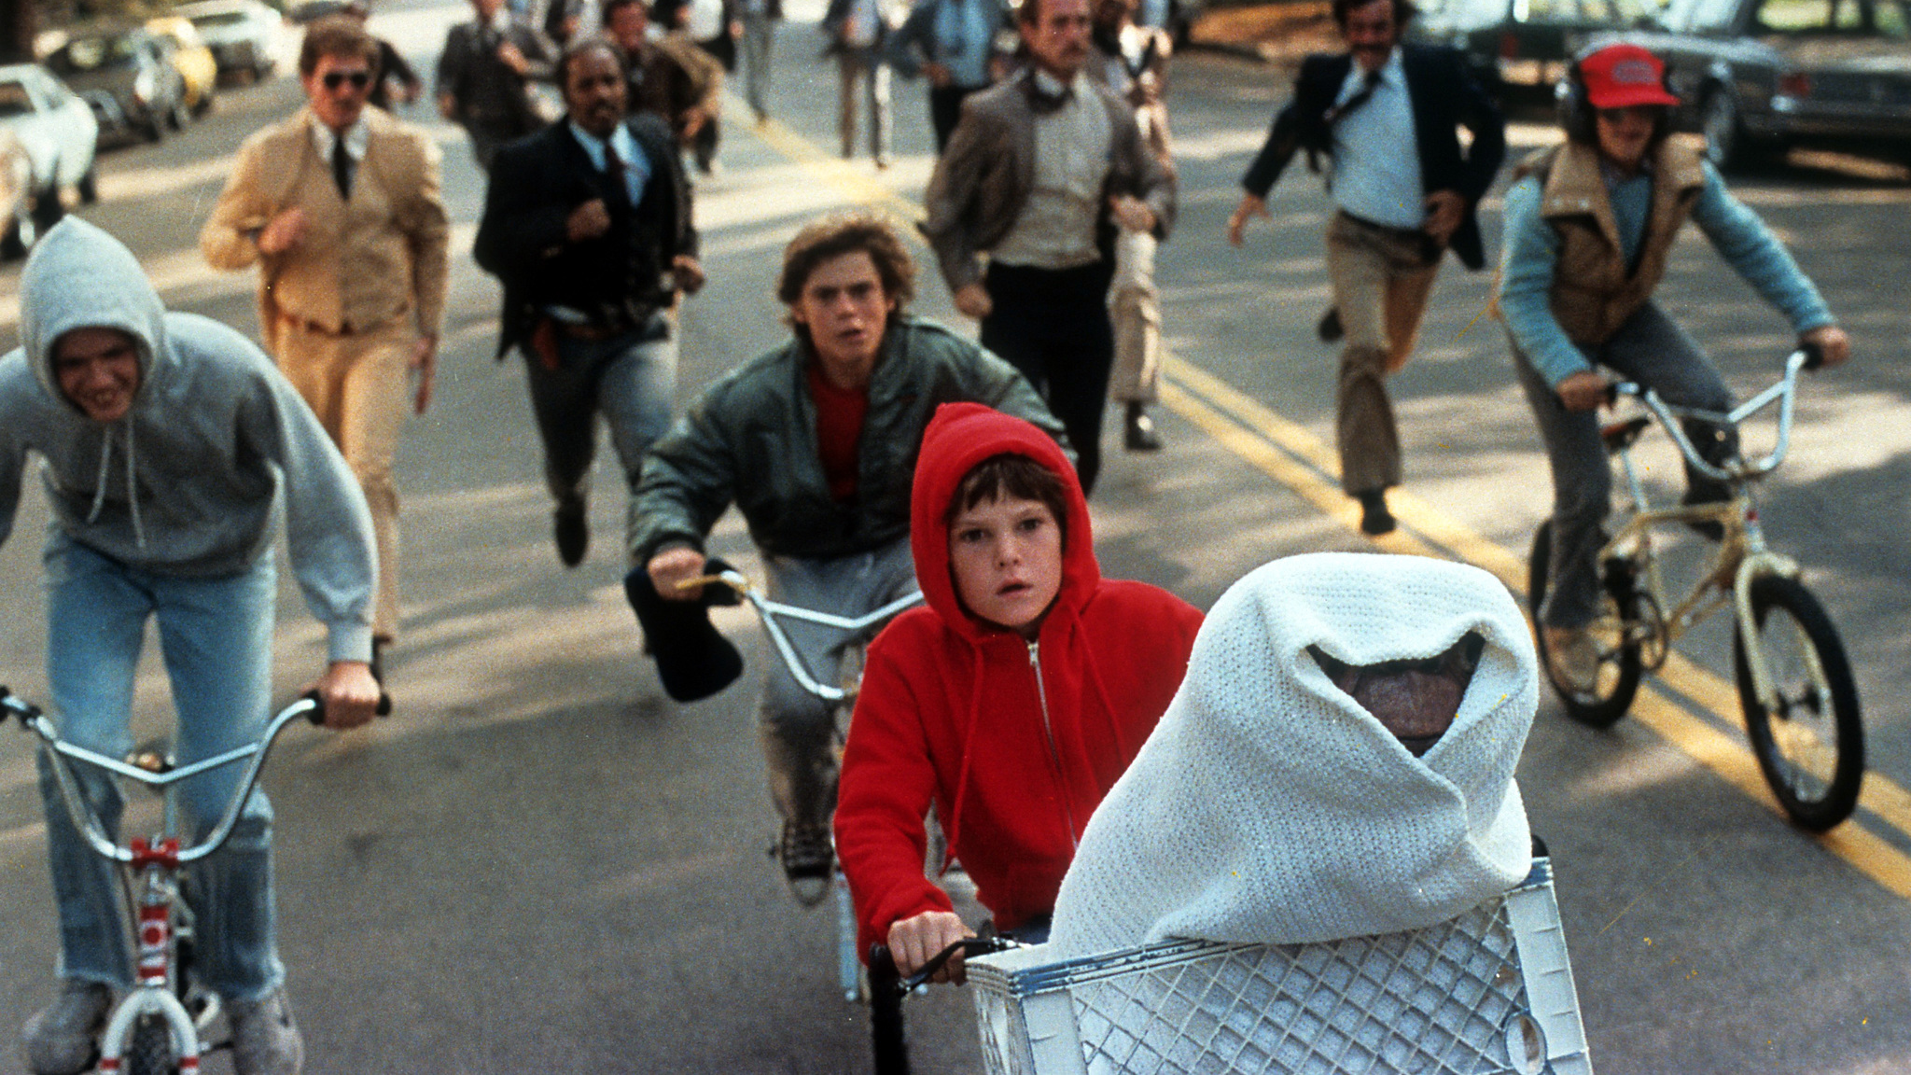
ET

Slide 6

Mary
Poppins

Slide 7
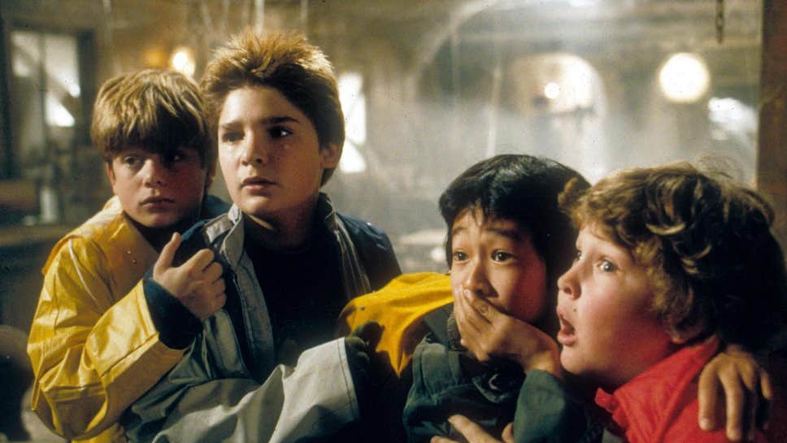
The Goonies

Slide 8
Round 2
Village Covidiot

Slide 9
The government has divided the nation into three tiers. But which tier is London in today?
Tier 2

Slide 10
If you live in Edinburgh. Can you order a pint at 9.45pm?
No

Slide 11
If you live in Newcastle upon Tyne. Are you allowed to get plasterer to come into your house to do some work?
Yes

Slide 12
If you live in Oakley, can two families of four meetup for a walk?
No

Slide 13
Which one of these isn’t a real UK government COVID-19 slogan, but which one?
“Person, woman, man, camera, TV”

Slide 14
Round 3
The Mystery Biscuit

Slide 15
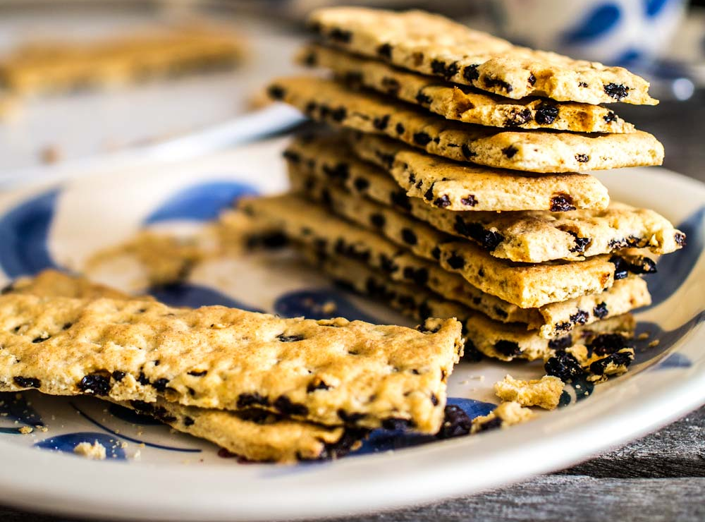
Garibaldi

Slide 16
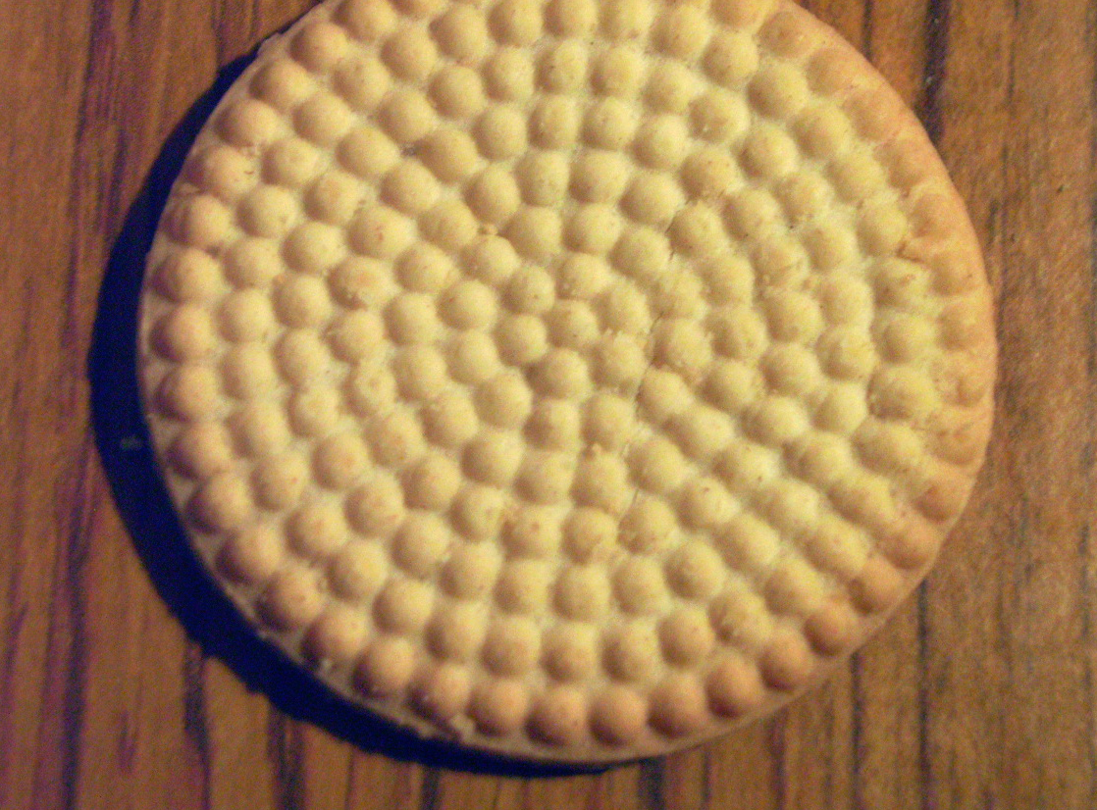
Lincoln

Slide 17
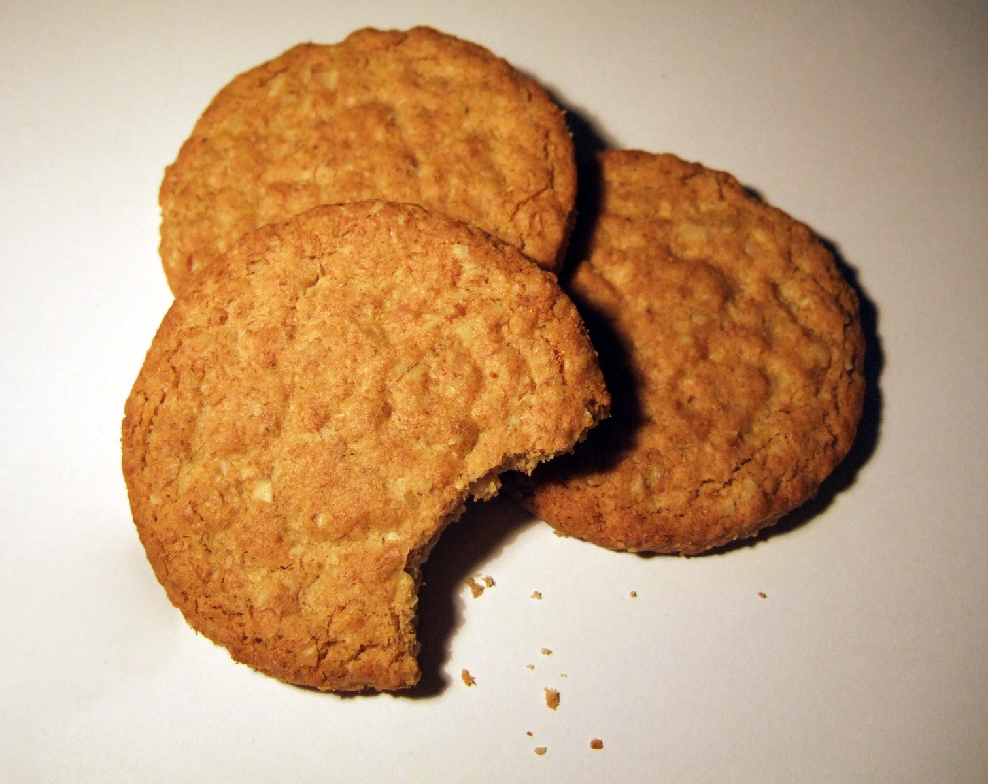
Hobnob

Slide 18
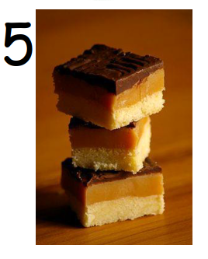
Millionaire’s
Shortbread

Slide 19
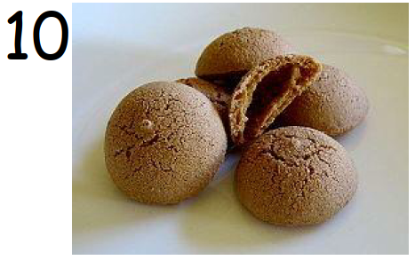
Amaretti

Slide 20
Round 4
ApOAKLEYpse Now

Slide 21

Deep Impact

Slide 22
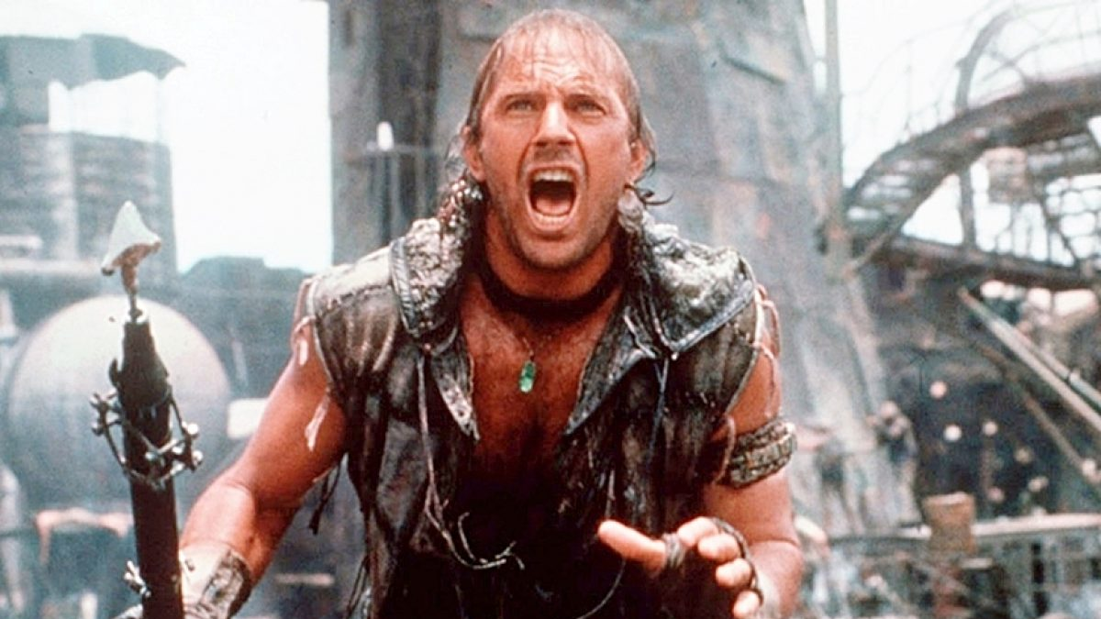
Waterworld

Slide 23
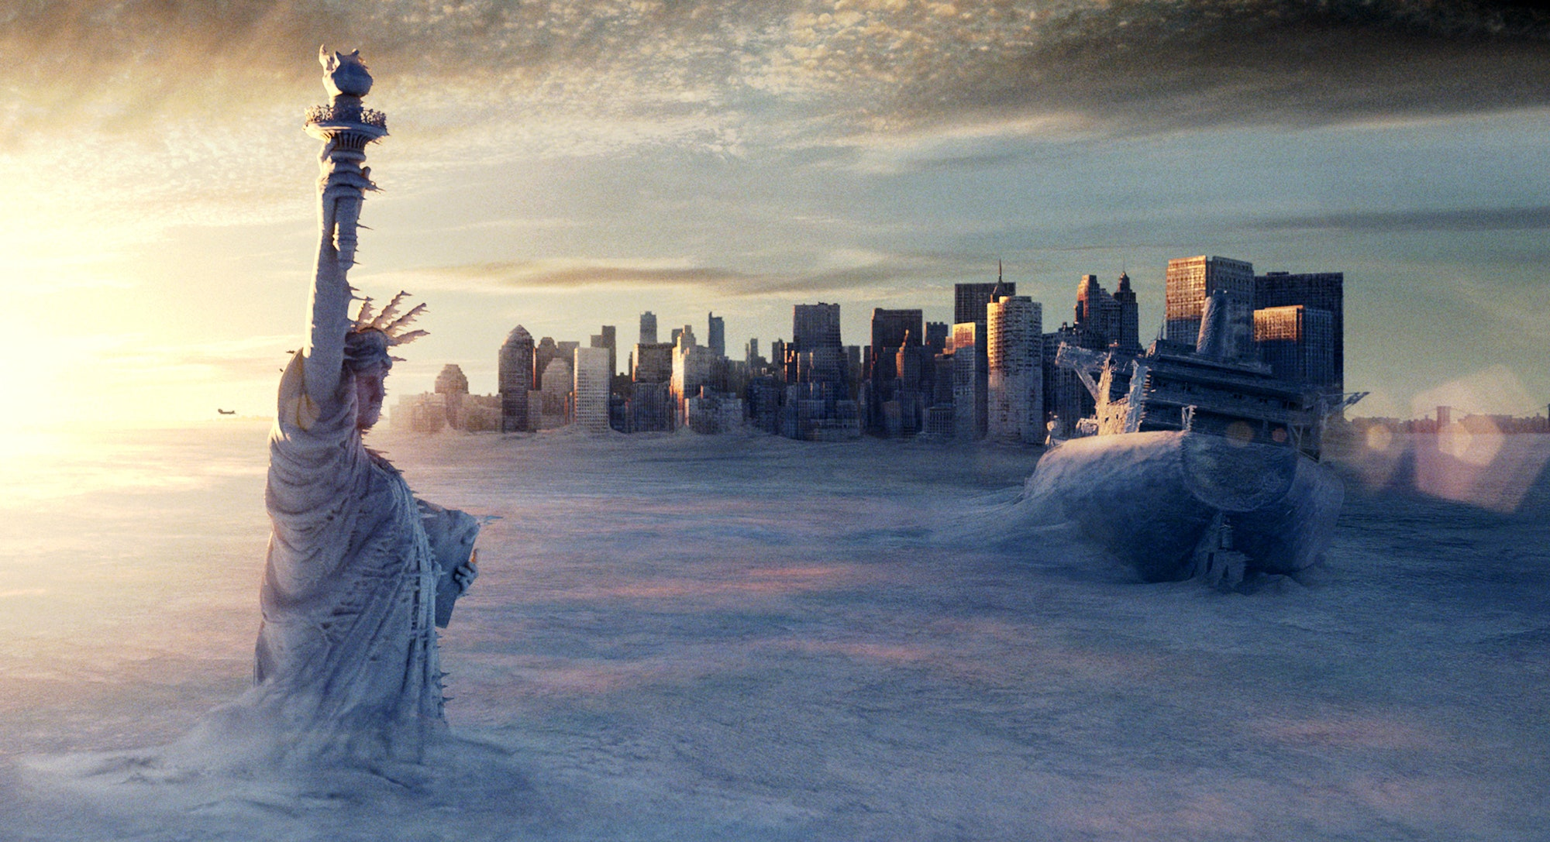
The Day After Tomorrow

Slide 24
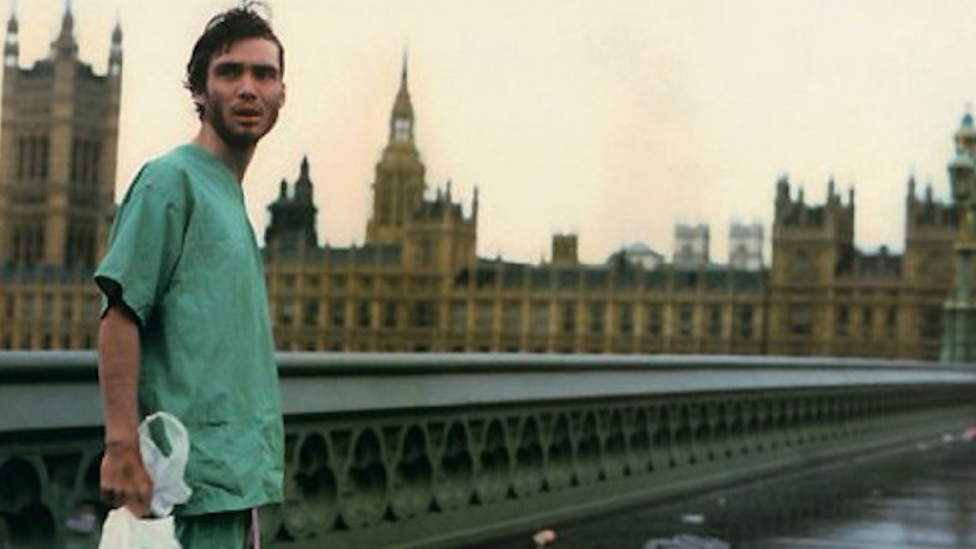
28 Days Later

Slide 25
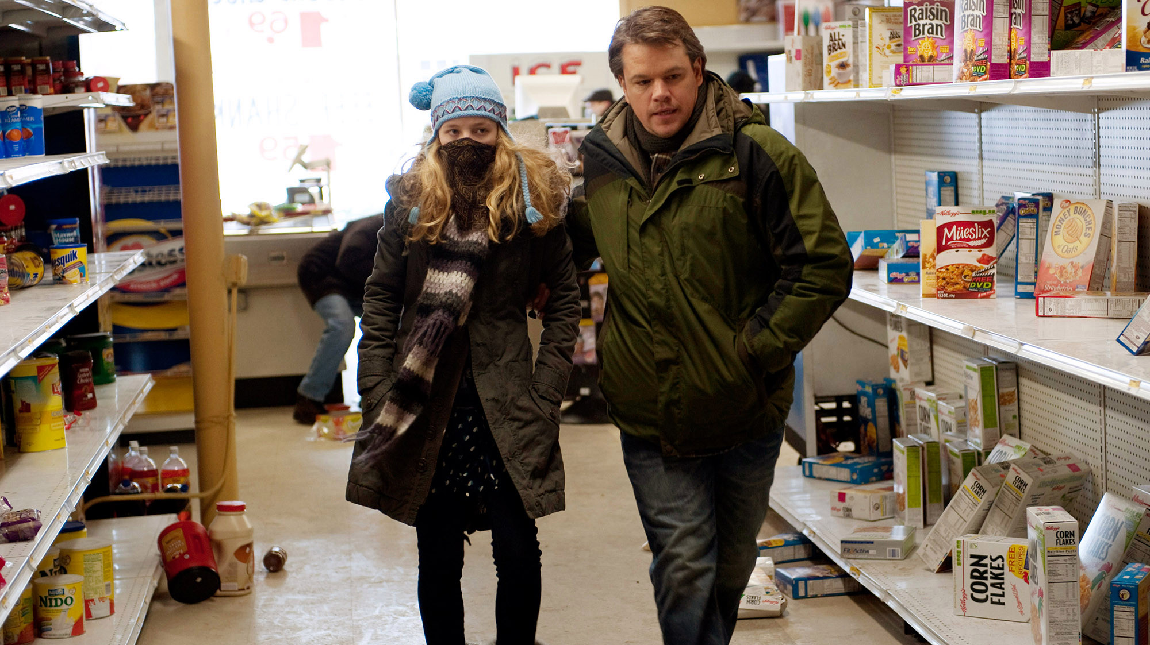
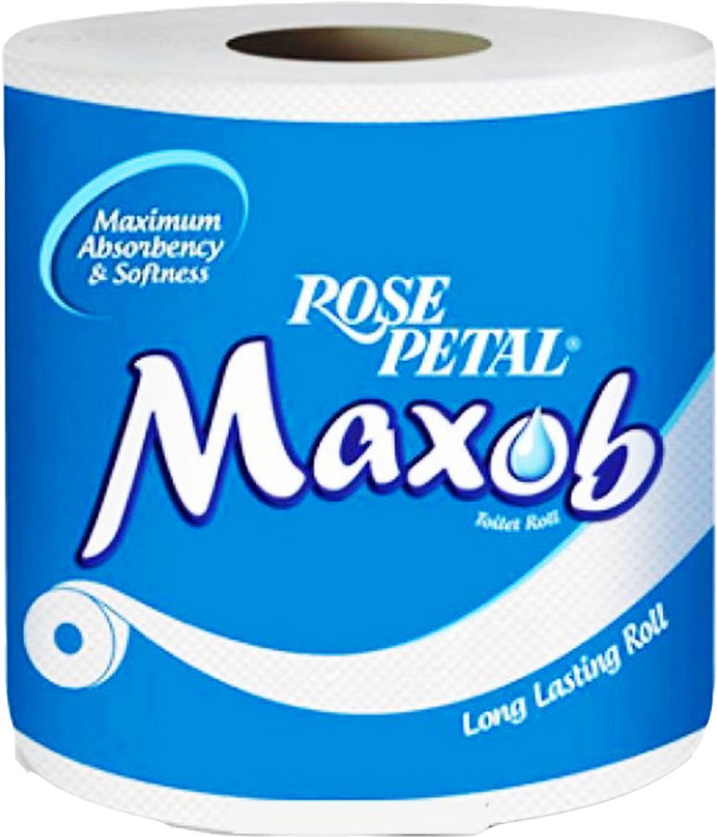
Contagion

Slide 26
Round 5
Band on the run

Slide 27
Which country are these bands from?
AC/DC
Australia

Slide 28
Daft Punk
France

Slide 29
Arcade Fire
Canada

Slide 30
Scorpions
Germany

Slide 31
ABBA
Sweden

Slide 32
Round 6
“You’re gonna need a bigger quote!”

Slide 33
“Chewie, we’re home!”
Star Wars:
The Force Awakens

Slide 34
“I’m the king of the world!”
Titanic

Slide 35
“Hello. My name is Inigo Montoya. You killed my father. Prepare to die.”
The Princess Bride

Slide 36
“Roads? Where we're going we don't need roads.”
Back to the Future (Prt 1 or Prt2)

Slide 37
“I’ll have what she’s having”
When Harry Met Sally

Slide 38
Round 7
Pitch perfect

Slide 39
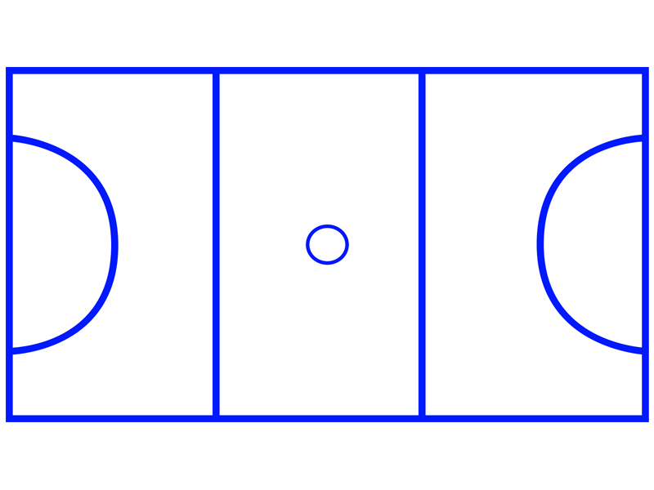
Netball

Slide 40
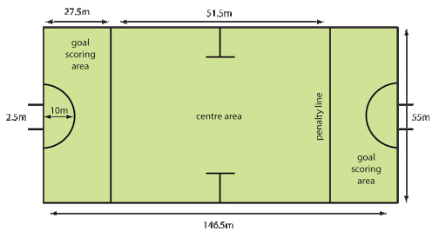
Hockey

Slide 41

Badminton

Slide 42
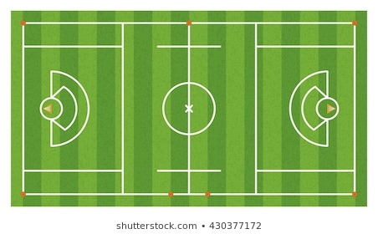
Netball

Slide 43
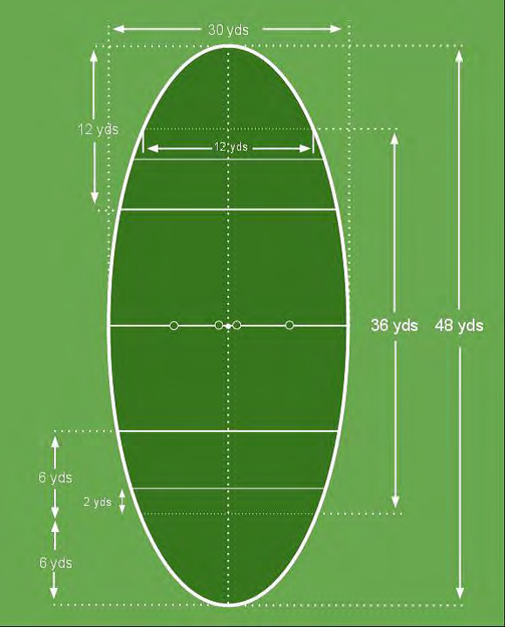
Quidditch

Slide 44
Round 8
The cherry on top

Slide 45
These are ingredients for which dessert…?
Sponge cake
Coffee
Brandy
Chocolate
Mascarpone
Tiramisu

Slide 46
White bread
Mixed berries
sugar
Summer
Pudding

Slide 47
eggwhite
Cream
Sugar
Fruit
Pavlova
(Or Eton Mess if you drop it)

Slide 48
Pastry
Sugar
Jam
Eggs
Almonds
Bakewell
Tart

Slide 49
Icecream
Jam
Sponge
Arctic Roll

Slide 50
That concludes the Answers

